Slide 1

Glass Evidence
19th August 2020

Slide 2
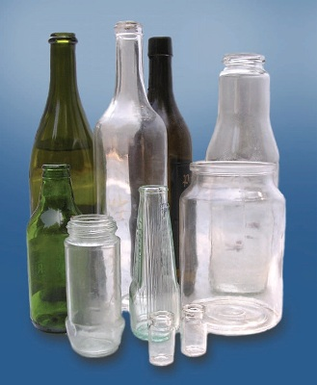
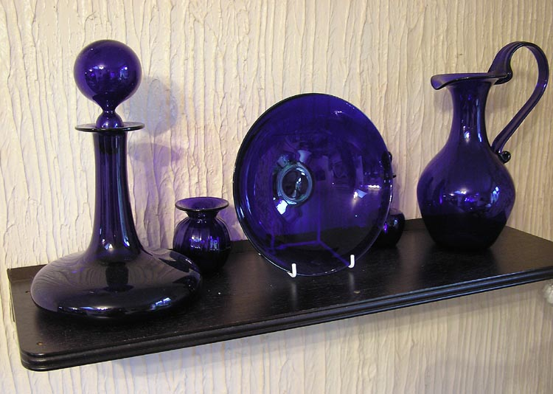
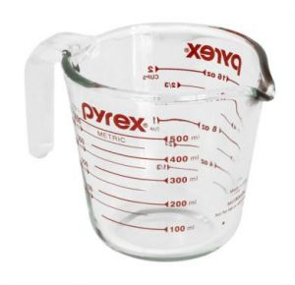
Types of glass according to chemical contents
The major content in all types of glass is silicon dioxide.
Glass with boron content (Borosilicate glass) is resistant to breaking when heated or cool and is employed in laboratory glassware and cookware.
Inexpensive soda lime glass is high in sodium and calcium content and is found as container and windows.
The addition of high atomic number elements (metals) increases the refractive index (RI) of glass, causing it to sparkle and serve decorative and aesthetic purposes.
Soda lime glass
Cobalt glass for decoration
Notes:
Soda ash = sodium carbonate หรือ flux ผสมลงไปใน sio2 เพื่อลดจุดหลอมเหลว
Lime = calcium containing inorganic such as calcium oxide, calcium hydroxide
Silicon dioxide Si)2
Soda = Sodium carbonate Na2CO3
Borion content ในที่นี้หมายถึง boron oxide B2O3
Lime = calcium oxide CaO

Slide 3

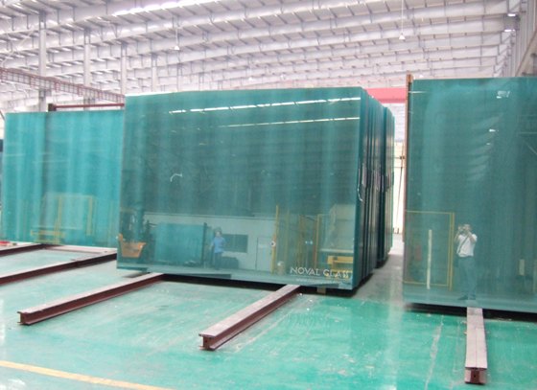
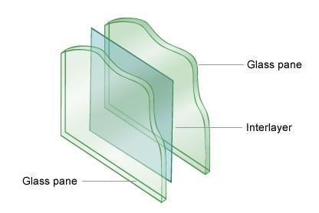
Types of glass according to structure
The glass contents are still composed of SiO₂, Na₂CO₃, CaCO₃ and other oxides.
Flat glass : used in doors and windows
Laminated glass : used in windshields, two sheets of glass with plastic between them.
Tempered glass : used in car side windows, cell phone protector and designed to break into tiny pieces.
Notes:
http://www.novalglass.com/glass/how-to-make-float-glass/
http://www.build.com.au/laminated-glass
http://www.ebay.com/sch/LG-Tempered-Glass-Cellphone-Screen-Protector/58540/bn_857475/i.html
Glass may be strengthened by tempering. This is process whereby the glass is heated and cooled rapidly, producing deliberate tensile stress in the surface.

Slide 4
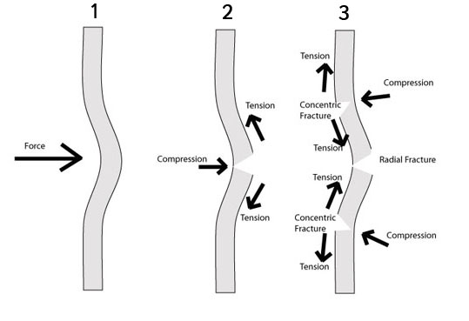
How do glass windows break?
Each force causes a deformation that may leave a visible mark or fracture the glass. This can be used to determine the direction and amount of force.
Glass acts initially as an elastic surface and bends away when a force is applied. When the force increases beyond its tensile strength, it cracks.
When glass is deflected, it has one face under compression and tension. Whilst the resistance of glass to compressive stress is extremely high, its resistance to tensile stress is significantly lower.
http://www.sqaacademy.org.uk/pluginfile.php/34022/mod_resource/content/2/Glass/fractures.html
Notes:
https://www.youtube.com/watch?v=0QeLz_iUF6c

Slide 5
Compressive strength and Tensile strength
The compressive strength of glass is extremely high: 800 -1000 MPa.
This means that to shatter a 1 cm cube of glass, it requires a load of some 10 tonnes.
The ability of a material to resist a force that tends to pull it apart.
It is usually expressed as the measure of the largest force that can be applied in this way before the material break apart.
The practical tensile strength is about 27 MPa to 62 MPa.
Note : Most glass breakage is due to tensile strength failure.
Notes:
Annealing – slowly heating and then cooling the glass. A heat treatment that alters the microstructure of a material causing changes in properties such as strength and harness.
http://www.roymech.co.uk/Useful_Tables/Matter/Glass.html

Slide 6
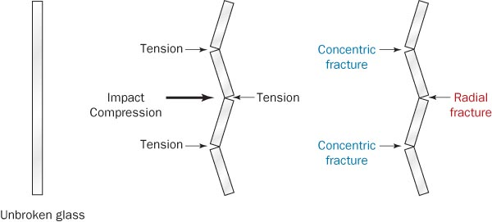
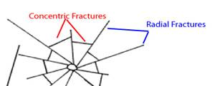
Fracture patterns in broken glass
Being an amorphous solid, glass will not break into regular pieces with straight line fractures
Radial fractures form first and are propagated in short segments on the side opposite the force.
Concentric fractures come later from continued pressure on the same side as the force applied.
Notes:
As a force is applied to the near surface of the glass, the glass bends elastically with the near surface under compression and the far surface under tension.
A fracture will start at a defect point on the opposite surface. The fracture will move towards the near surface and simultaneously move outwards from the central point of the fracture. Fractures that radiate from the central point are called radial fractures.
The fracture may stop at this point but there is still stress that has yet to be released. When the far surface is put under tension at the point of the force, areas around this tension are then compressed. This stress causes tension on the near surface of the glass which can cause fractures on the near surface.
These fractures form a circle around the original fracture and are called concentric fractures. The fractures are formed between the radiating fractures this can be seen in the diagram

Slide 7
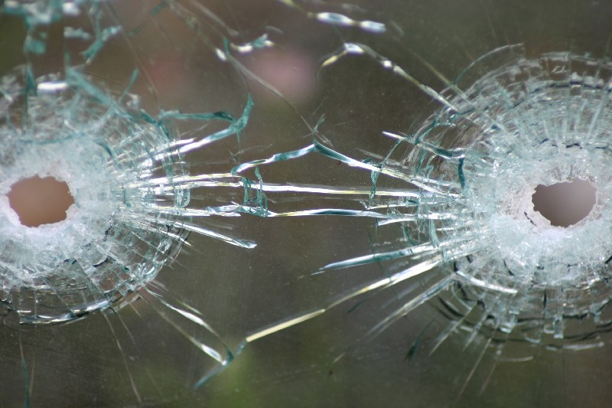
Fracture patterns provide clues about the direction, rate, and sequence of the impacts.
Which bullet hole was created first?

Slide 8

http://www.khaosod.co.th/view_newsonline.php?newsid=TVRNMU16VTRPRFUzTnc9PQ==&subcatid=

Slide 9
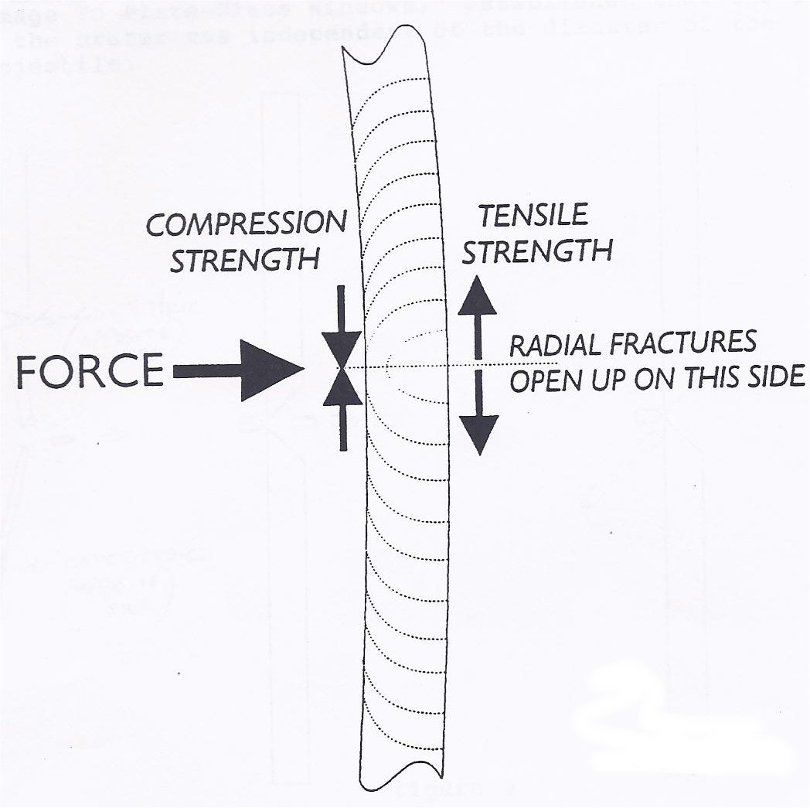
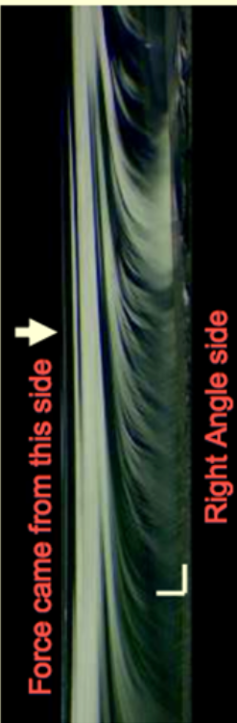
3R Rule
Edges of broken pieces of glass will show rib (“stress”) marks.
In a radial crack, the rib marks are perpendicular to unloaded side and parallel to loaded side.
The force arrow shows the side that received the impact.
3R rule:
  Radial cracks give rib marks that make
  Right angles on the
  Reverse side from where the force was applied
https://deathbetweenthecovers.wordpress.com/
https://slideplayer.com/slide/4888394/

Slide 10
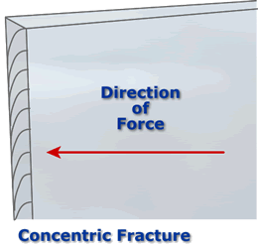
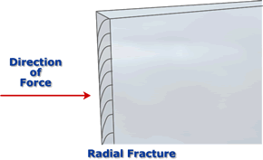
Rib marks
Radial fracture vs concentric fracture
Stress lines on the glass edge of radial cracks form a right angle on the reverse side from the force.
Stress lines on the glass edge of concentric cracks form a right angle on the same side as the force.

Slide 11
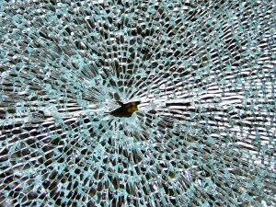
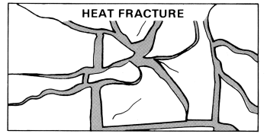
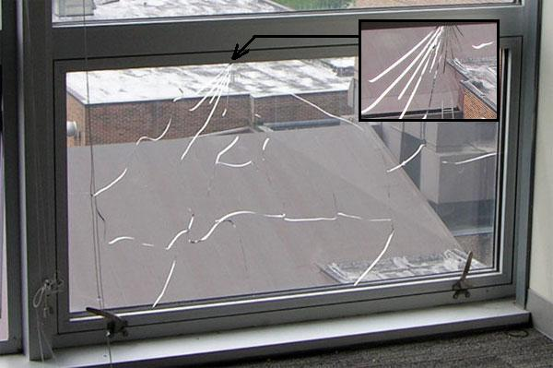
Exceptions to the Three R Rule
Tempered glass
  “dices” without forming ridges
Very small windows held tightly in frame
  can’t bend or bulge appreciably
Windows broken by heat or explosion
  no “point of impact”
  curved, smooth edges at break points

Slide 12
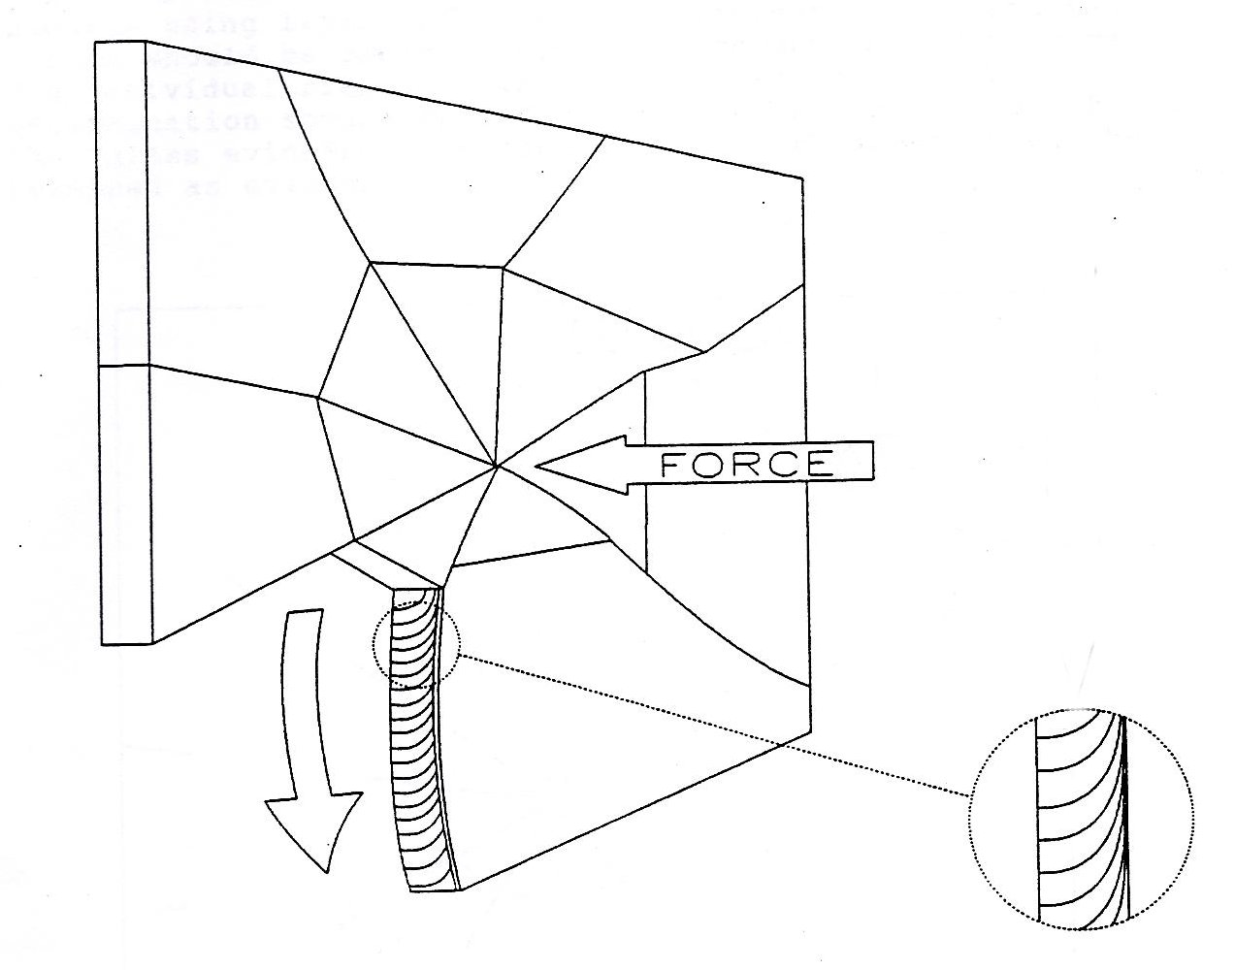
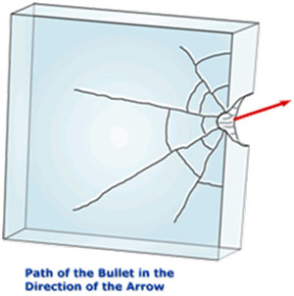
Glass Fractures by Projectiles
Bullets are a projectile force (load) that can pass through glass.
  Load side is the entrance side; unloaded side is the exit side.
  Low-speed projectiles: rib marks may indicate where breaking force was applied
  As the bullet’s velocity increases, the central hole becomes smaller, cracking patterns become simpler, and the exit hole becomes wider than the entrance hole.
https://deathbetweenthecovers.wordpress.com/2013/04/04/hearts-may-be-made-of-glass-but-so-are-windows/
http://www.crimemuseum.org/crime-library/glass-analysis

Slide 13
Forensic Examination of Glass
Goals in examining glass evidence:
  Determine the types of glass at the scene
  Determine how the glass was fractured
  Use physical characteristics to classify it
  Individualize the glass to a source
Compare physical and chemical characteristics:
  Optical properties: color and refractive index
  Non-optical properties: surface wear, striations from manufacturing, thickness, surface film or dirt, hardness, density
  Chemical properties: additives or trace elements

Slide 14
Glass type determinations
The preliminary tests based on basic properties, such as color, thickness, and curvature, can also help to identify different samples of glass just by looking at them.
The most important physical characteristics of glass fragments are density and refractive index.
The chemical characteristics in terms of elemental analysis can also be conducted. Measurement of the types and quantities of these elements can help in determining whether two pieces of glass were ever part of the same object.

Slide 15
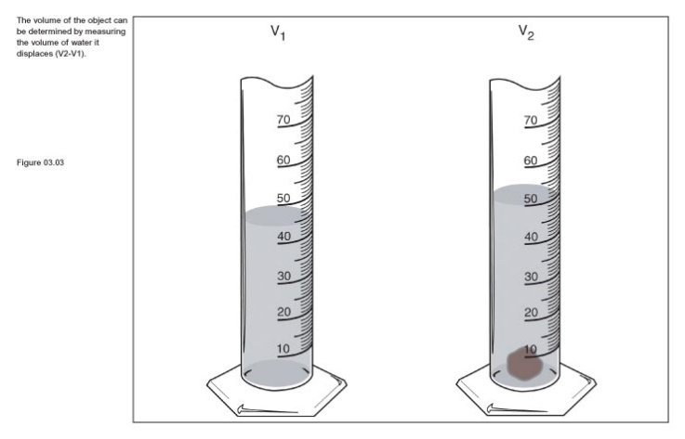
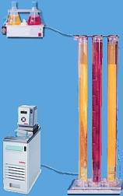
Glass Density
Density can be measured by:
  directly determining mass and volume (usually by displacement)
  comparison by flotation
  comparison using a density gradient column
Density gradient column method:
  Fragments of different densities settle at different levels in the column of liquid of varying density.
  Technique is not accurate for fragments that are cracked or contain an inclusion.

Slide 16
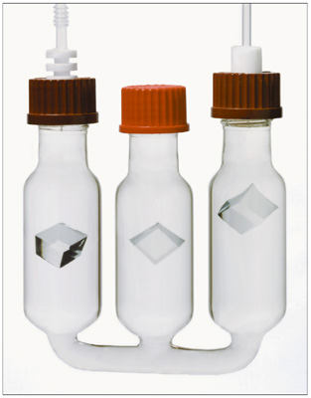
Density by the Flotation Method
A glass particle is immersed in a liquid. The density of the liquid is adjusted by the addition of small amounts of another liquid until the glass chip remains suspended.
At this point, the glass will have the same density as the liquid medium and can be compared to other relevant pieces of glass which will remain suspended, sink, or float.

Slide 17
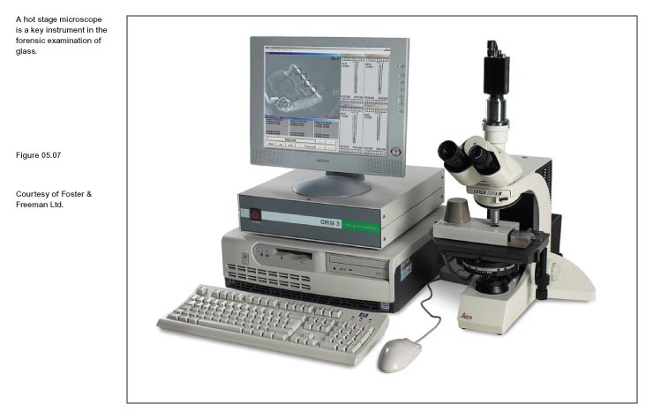
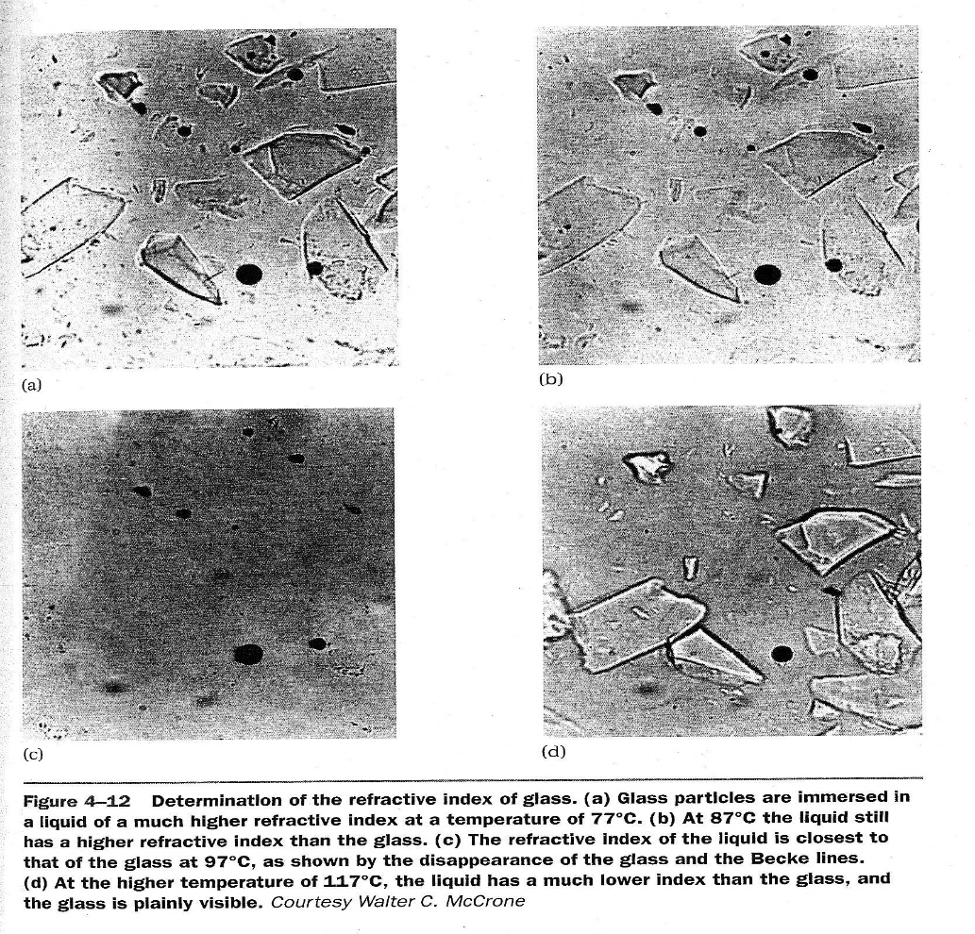
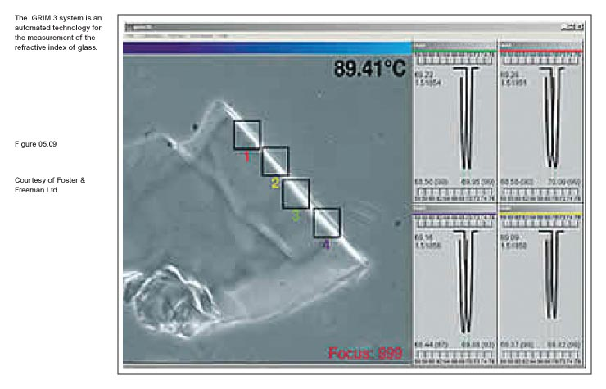
Refractive Index By Immersion

Slide 18
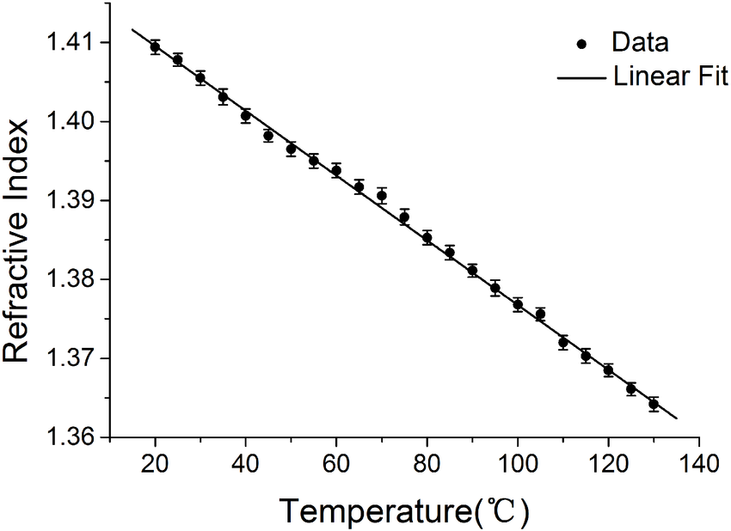
The refractive index of silicon oil vs temperature
Article in PLoS ONE 11(3):e0151454 · March 2016
DOI: 10.1371/journal.pone.0151454

Slide 19


